Slide 1

Database Management Systems (DBMS)
By Alex Joslin

Slide 2
What is a DBms?
A DBMS makes it possible for end users to create, protect, read, update and delete data in a database. It is the software that maintains a database
A Database is an organized collection of data
There are different types of Databases

Slide 3
SQL & relational Databases
Relational Databases are consisted of tables.
And we interact with that database using a language called SQL
SQL (Simple Query Language)
There are many different flavors of SQL such as:
MySQL
PostgresSQL
SQLite
SQL Server
Oracle SQL
MariaDB

Slide 4
Example
Employee Table
id | emp_name | emp_age | dep
132 | Lisa | 35 | Software
264 | John | 27 | Finance
349 | Nick | 52 | Marketing
Department Table
department | building | employee_count
Software | F-3 | 16
Finance | F-6 | 8
Marketing | F-2 | 25

Slide 5
Example
Foreign Key
Employee Table
id | emp_name | emp_age | dep
132 | Lisa | 35 | Software
264 | John | 27 | Finance
349 | Nick | 52 | Marketing
Department Table
department | building | employee_count
Software | F-3 | 16
Finance | F-6 | 8
Marketing | F-2 | 25
Primary Key

Slide 6
Example
Primary Key
Foreign Key
Employee Table
id | emp_name | emp_age | dep
132 | Lisa | 35 | Software
264 | John | 27 | Finance
349 | Nick | 52 | Marketing
Department Table
department | building | employee_count
Software | F-3 | 16
Finance | F-6 | 8
Marketing | F-2 | 25
Primary Key

Slide 7
Example
Primary Key
Foreign Key
Employee_Table
id | emp_name | emp_age | dep
132 | Lisa | 35 | Software
264 | John | 27 | Finance
349 | Nick | 52 | Marketing
Get John’s building #
SELECT building
FROM Department_Table
WHERE department = (
SELECT dep
FROM Employee_Table
WHERE emp_name=“John”
)
Department_Table
department | building | employee_count
Software | F-3 | 16
Finance | F-6 | 8
Marketing | F-2 | 25
Primary Key

Slide 8
No SQL & Non-Relational Databases
These databases have flexible schemas and scale easier than relational databases.
There are many No SQL Databases such as:
MongoDB
Redis
Amazon DynamoDB
Azure Cosmos DB
Google Cloud Datastore

Slide 9
Exmaple
Employee_Collection
Select the employee whose age is 35
{
id: 132,
emp_name: Lisa,
emp_age: 35,
dep: {
department: Software,
building: F-3
employee_count: 16
}
}
db.Employee_Collection.find({ emp_age:35 })

Slide 10
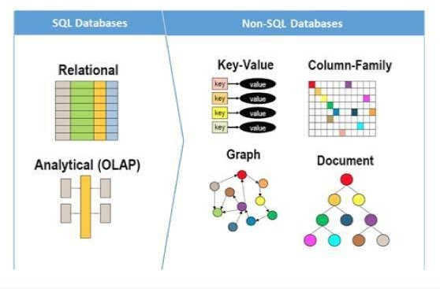

Slide 11
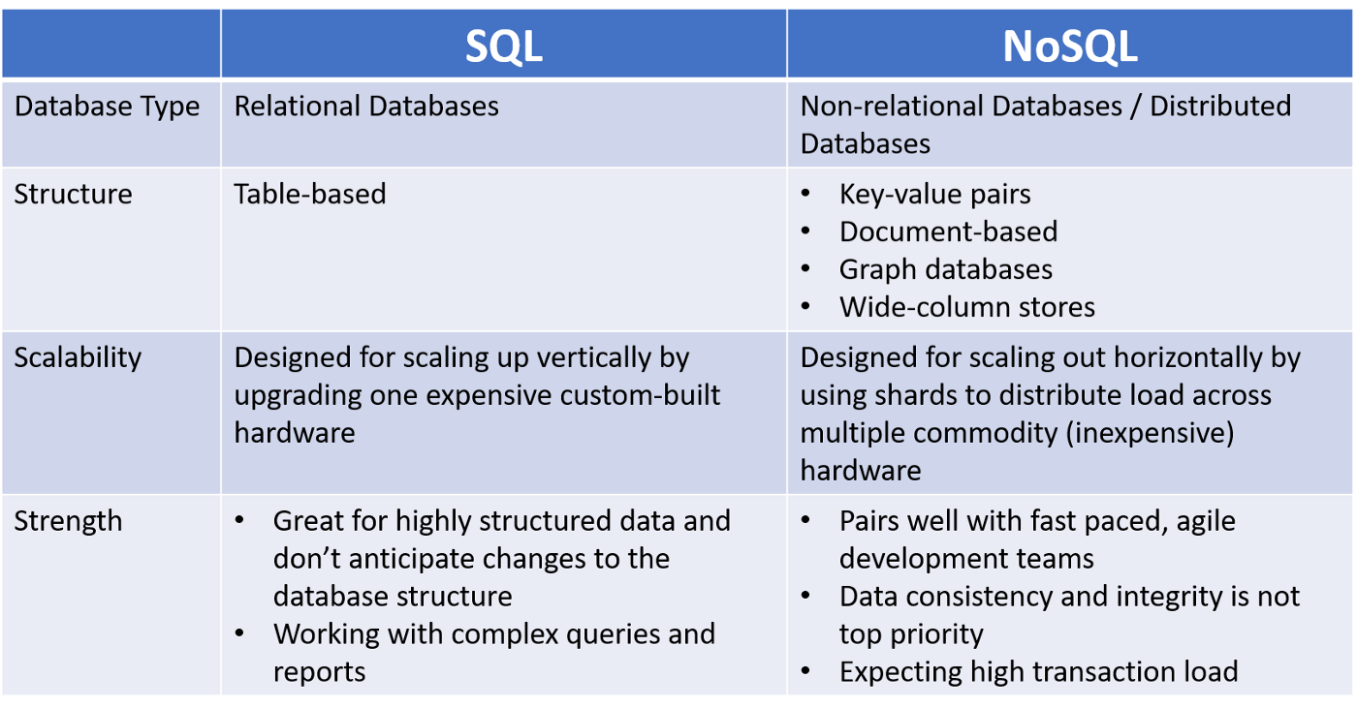
SQL vs NoSQL

